Slide 1

DATA SCIENCE PROJECT
Retail Customer
Churn Prediction
Time-Based ML Modeling with
Revenue Optimization
1M+
~6K
7.6x
Transaction Records
Unique Customers
Simulated ROI

Slide 2
PROJECT OVERVIEW
Project Roadmap
01
Business Problem & Objectives
02
Data Foundation
Defining the churn prediction challenge and strategic revenue optimization goals
Exploring 1M+ retail transactions, data quality assessment, and preprocessing pipeline
03
Methodology & Feature Engineering
04
Model Performance & Results
Time-based churn definition, RFM analysis, and behavioral feature extraction
Three-algorithm comparison, evaluation metrics, and SHAP explainability analysis
05
Key Insights & Business Impact
Revenue-at-risk simulation, ROI-optimized targeting strategy, and strategic recommendations for customer retention

Slide 3
BUSINESS CONTEXT
The Churn Challenge
Core Business Question
Project Objectives
"Which customers are likely to churn in the next 90 days?"
Build a time-aware churn prediction system
Connect predictions to revenue impact
Optimize retention strategy for ROI
Strategic Importance
Key Differentiator
"How can churn predictions be translated into profitable retention strategy?"
Most churn projects stop at accuracy metrics. This project goes beyond:
Forward-looking validation (leakage-free)
Revenue-at-risk simulation
The Revenue Impact
ROI-optimized targeting strategy
Customer churn directly affects bottom-line revenue. Proactive retention is more cost-effective than acquisition.

Slide 4
DATA FOUNDATION
Dataset Overview: 1M+ Transaction Records
1,067,371
5,942
53,628
7.55
Total Transactions
Unique Customers
Unique Invoices
Avg Transactions
Raw dataset size
Distinct Customer IDs
Transaction groups
Per customer
Time Coverage
Data Schema
Start Date
Dec 1, 2009
Invoice
StockCode
Object
Object
End Date
Dec 9, 2011
Description
Quantity
Object
int64
Total Duration
~2 Years
InvoiceDate
Price
Object
float64
CustomerID
Country
float64
Object

Slide 5
DATA PREPARATION
Data Quality & Preprocessing Pipeline
Cleaning Steps
Removed Cancelled Invoices
Eliminated returned orders
Dropped Anonymous Purchases
243K missing Customer IDs
Removed Negative Values
Quantity & price validation
Created Revenue Feature
Revenue = Quantity × UnitPrice
Memory Usage
65.1+ MB

Slide 6
METHODOLOGY
Time-Based Churn Definition: Leakage-Free Approach
Time Window Configuration
Churn Definition
Cutoff Date
2011-09-01
A customer is labeled as churned if they make no purchase within 90 days after the cutoff date.
Feature engineering ends here
Prediction Window
90 Days
57.3%
42.7%
Future period for churn label
Churned
Retained
Leakage Prevention
Temporal Split Strategy
This forward-looking approach mirrors real-world deployment and prevents target leakage by strictly separating historical features from future labels.
Historical Window
Dec 2009 → Sep 2011 (Feature Engineering)
Future Window
Sep 2011 → Dec 2011 (Churn Label)

Slide 7
FEATURE ENGINEERING
RFM & Behavioral Metrics
RFM
RFM Features
B
Behavioral Features
Recency
Interpurchase Gap
Basket Value
Days since last purchase. Lower recency = lower churn risk.
Mean & Std of purchase intervals
Mean & Std of transaction values
Revenue Trend
Diversity Ratio
Frequency
Linear regression slope
Product category variety
Number of transactions. Higher frequency = stronger loyalty.
Seasonality Ratio
Purchase pattern consistency across time periods
Monetary Value
Total revenue generated. Higher value = more stable customer.
Feature Engineering Goal
Capture customer behavior patterns that predict future churn probability

Slide 8
MODEL DEVELOPMENT
Three-Algorithm Comparison
Logistic
Regression
Random
Forest
XGBoost
Type
Type
Type
Linear Classifier
Ensemble (Bagging)
Gradient Boosting
Strengths
Strengths
Strengths
• Interpretable coefficients
• Handles non-linearity
• State-of-the-art performance
• Fast training & inference
• Feature importance
• Regularization built-in
• Good baseline performance
• Reduces overfitting
• Efficient handling of missing values
Use Case
Use Case
Use Case
Probability estimation with explainability
Complex pattern recognition
High-performance prediction
Training Configuration
Train/Test Split: 80/20 with stratification
Random State: 42 (reproducibility)
Preprocessing: StandardScaler for feature normalization

Slide 9
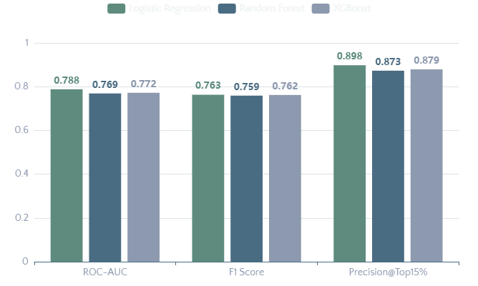
EVALUATION RESULTS
Model Performance Comparison
Performance Metrics
Best Performer
Logistic Regression
Slightly outperformed tree-based models
Under leakage-free validation, the linear model achieved the best ROC-AUC score, demonstrating robust generalization.
Key Metrics Explained
ROC-AUC
Ability to distinguish churners from non-churners
F1 Score
Balance between precision and recall
Precision@Top15%
Accuracy of high-risk customer identification

Slide 10
MODEL EXPLAINABILITY
SHAP Analysis: Key Churn Drivers
1
Recency is the Strongest Driver
3
High-Value Customers Are More Stable
Customers with longer inactivity periods have significantly higher churn probability.
Higher monetary value reduces churn probability. Loyal customers spend more.
Lower Recency = Lower Churn Risk
Higher Monetary = More Stable
2
Behavioral Instability Predicts Churn
SHAP Approach
High volatility in purchase intervals (GapStd) increases churn risk significantly.
Quantify global feature importance
Understand directionality of impact
Irregular patterns = Warning signal
Validate behavioral assumptions
Key Insight: Recency, behavioral volatility, and monetary value are the top 3 predictors of customer churn.

Slide 11
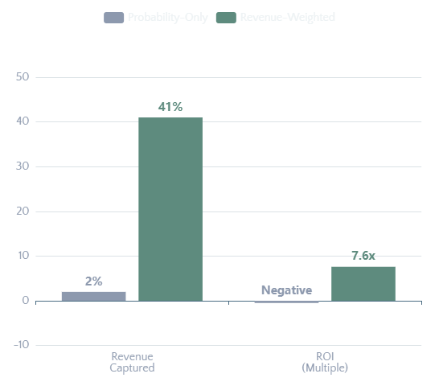
BUSINESS SIMULATION
Revenue-at-Risk: Strategic Targeting
Probability-Only Targeting
Targeting Strategy Comparison
Revenue Captured
~2%
Of total revenue-at-risk
ROI
Negative
Targeting fails to capture value
Problem: High churn probability ≠ High revenue impact
Revenue-Weighted Targeting
Risk Score Formula
Risk = P(Churn) × Monetary
Revenue Captured
41%
Of total revenue-at-risk
Simulated ROI
7.6x
Dramatic improvement

Slide 12
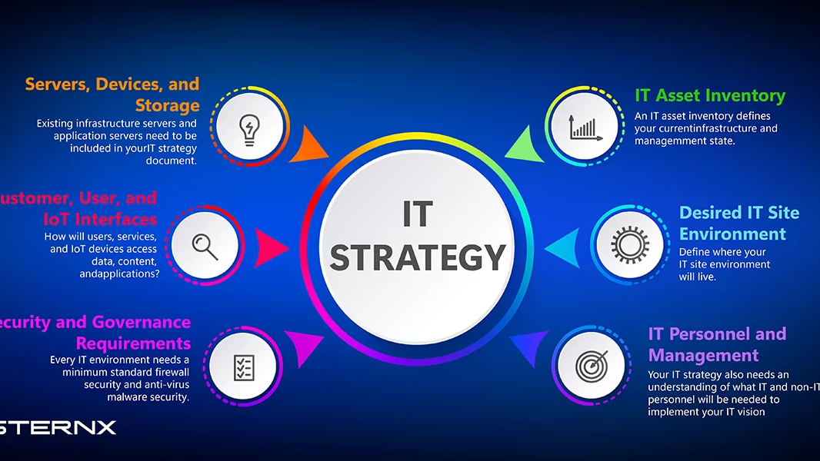
PROJECT IMPACT
Key Takeaways
& Strategic Value
Leakage-Free Validation
Financial Outcomes
Profitability Focus
Forward-looking time-based approach prevents data leakage and mirrors real-world deployment.
Connects ML predictions directly to revenue impact and retention ROI optimization.
Revenue-weighted targeting achieves 7.6x ROI vs negative ROI with probability-only approach.
Why This Project Stands Out
Most churn projects stop at accuracy metrics. This project demonstrates both technical depth and strategic thinking by connecting ML outputs to business value.
Technical Excellence
Business Impact
Strategic Value

